Slide 1
EXCEL PROJECT/ SQL PROJECT [AI DUBAI FRAGRANCE SALE] Presented by: Prathmesh Pawan Mhatre

Slide 2
INTRODUCTION- EXCEL
We have raw dataset based on the sales of AI Dubai fragrances for a particular year.
We will be relating and analysing some problems based upon this.
Source of data : https://www.Kaggle.com/datasets .
We will be solving following statements:
Ratio of male and females in total customers of app/non-app users..
Top and worst performing gender in sales.
Top and worst performing users(app & non-app)
Top 5 customers contributing to sales of fragrance.
Top 10 sales transactions.
Month wise sales of total product in USD.

Slide 3
COLUMN DESCRIPTION
Below is the description of columns in data .
Column | Definition
Customer id | Unique Key to identify a Member
App User | Flag to identify if the Member uses the APP
BEAUTY Sales USD | Total Member Sales in Beauty Brands in $
FASHION Sales USD | Total Member Sales in Fashion Brands in $
TOTAL Sales USD | Total Member Sales in $
Redeemed points Flag | Flag to identify if the Member has redeemed any points
Transactions | Number of Purchases made by the Member
Last Transaction date | Last Purchase date made by the Member
DOB | Member date of birth
EMAIL Flag | Flag to show if we have the Member email id
Gender | Member Gender

Slide 4
RATIO OF MALE AND FEMALE CUSTOMERS
Below shows the distribution of total customers who are using apps classified by gender.
Below that shows the distribution of total customers who are not using apps classified by gender.
Row Labels | Count of Gender
female | 80.54%
male | 19.46%
Grand Total | 100.00%
Row Labels | Count of Gender
female | 74.25%
male | 25.75%
Grand Total | 100.00%

Slide 5
TOP / WORST PERFORMING SALES AS PER GENDER
Below shows top performing gender which is contributing most to the sales, male is contributing more than female.
Below that shows worst performing gender according to sales.
Row Labels | Average of TOTAL Sales USD
female | 4285.497013
male | 4992.388452
Grand Total | 4423.0525
Row Labels | Average of TOTAL Sales USD
female | 182.9762346
male | 195.3239683
Grand Total | 186.1553153

Slide 6
TOP/ WORST PERFORMING USERS
Below shows the users who are top in performance classified by app and non app users.
Below that shows the worst performing app users .
Row Labels | Count of App User
0 | 3616
1 | 4096
Grand Total | 7712
Row Labels | Count of App User
0 | 11411
1 | 1703
Grand Total | 13114

Slide 7
TOP 5 CUSTOMERS ACCORDING TO THEIR CONTRIBUTION IN SALES.
Row Labels | Sum of TOTAL Sales USD
58583079 | 30.49%
288867385 | 16.65%
326868858 | 14.56%
785179211 | 23.21%
790144670 | 15.09%
Grand Total | 100.00%

Slide 8
TOP 10 TRANSACTIONS WITH RESPECT TO SALES
Below shows the top 10 transactions for the desired sale.
Row Labels | Sum of Transactions
58583079 | 202
112543542 | 83
132289856 | 268
383553221 | 101
490752998 | 171
560615311 | 107
790144670 | 84
859450131 | 96
943543431 | 92
999439698 | 106
Grand Total | 1310

Slide 9
MONTH WISE SPENT TOTAL USD
Below graph shows the distribution of total spent dollars in sales for each month in a year.
From the graph it is clear that maximum sale has occurred in the month of November 2019 and least in April 2020.
Row Labels | Sum of TOTAL Sales USD | Month Wise Total Spend
2019
Aug | 166405.254 | 0.22%
Sep | 572262.5592 | 0.77%
Oct | 788245.0907 | 1.07%
Nov | 942424.572 | 1.27%
Dec | 1657631.579 | 2.24%
2020 |  | 0.00%
Jan | 1933782.441 | 2.61%
Feb | 1814360.457 | 2.45%
Mar | 1140198.039 | 1.54%
Apr | 74221.35939 | 0.10%
May | 1076785.649 | 1.46%
Jun | 2479183.461 | 3.35%
Jul | 5789602.066 | 7.83%
Aug | 7041908.99 | 9.52%
Sep | 7961607.586 | 10.76%
Oct | 13130778.97 | 17.75%
Nov | 27404621.7 | 37.05%
Grand Total | 73974019.77

Slide 10
INTRODUCTION-SQL
We have raw dataset based on the sales of AI Dubai fragrances for a particular year.
We will be relating and analysing some problems based upon this.
Source of data : https://www.Kaggle.com/datasets .
We will be solving following statements:
Load Data ‘hr’
Find the number of employees working in the ‘Sales’ department. (Use sub-query).
Join the 3 tables and find the country-id wise count of employees and the avg salary. Which country has the maximum number of employees and which country has the maximum average salary?
Find the top 5 managers according to their salary.
Find the department name-wise percentage of employees working under each department. Which department is having the maximum percentage of employees?
Find the number of people working under each manager?
Find the eomployees, First_name ,DEPARTMENT, and country_id of employees whose salary is greater than equal to 12000

Slide 11
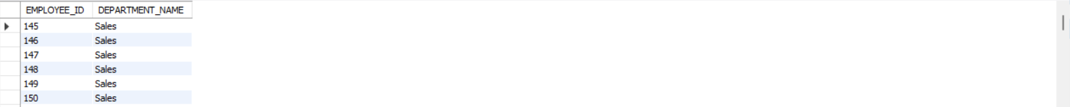
1.Find the number of employees working in the ‘Sales’ department. (Use sub-query).
with abc as (Select e.EMPLOYEE_ID,d.DEPARTMENT_NAME
From department_data d
join employees_data e
on d.DEPARTMENT_ID = e.DEPARTMENT_ID)
select EMPLOYEE_ID,DEPARTMENT_NAME
from abc
where DEPARTMENT_NAME= 'Sales';

Slide 12
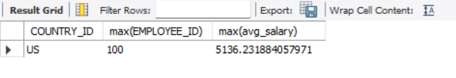
2.Join the 3 tables and find the country-id wise count of employees and the avg salary. Which country has the maximum number of employees and which country has the maximum average salary?
with a as(
Select e.EMPLOYEE_ID,avg(e.SALARY) avg_salary,l.COUNTRY_ID
From department_data d
join employees_data e
On d.DEPARTMENT_ID=e.DEPARTMENT_ID
join locations_data_u l
on d.LOCATION_ID=l.LOCATION_ID)
select COUNTRY_ID , max(EMPLOYEE_ID) , max(avg_salary)
from a
group by COUNTRY_ID;

Slide 13
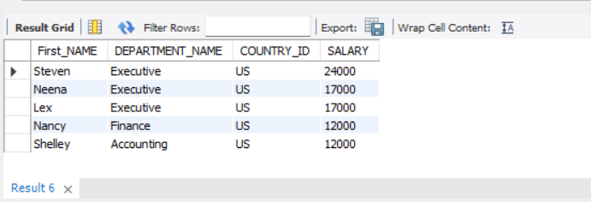
3.Find the top 5 managers according to their salary.
Select e.FIRST_NAME,e.LAST_NAME,d.MANAGER_ID,e.SALARY
From department_data d
join employees_data e
on d.DEPARTMENT_ID=e.DEPARTMENT_ID
group by 1,2
having max(SALARY)
order by SALARY desc
limit 5 ;

Slide 14
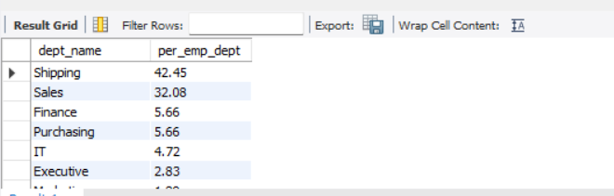
4. Find the department name-wise percentage of employees working under each department. Which department is having the maximum percentage of employees?
with employee as (
select b.DEPARTMENT_NAME as dept_name , count(a.EMPLOYEE_ID)as num_emp
from employees_data as a
join department_data as b
on a.DEPARTMENT_ID=b.DEPARTMENT_ID
group by b.DEPARTMENT_NAME)
select dept_name,round(num_emp / sum(num_emp) over() * 100,2) as per_emp_dept
from employee
group by dept_name
order by per_emp_dept desc;

Slide 15
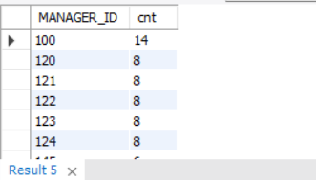
5. Find the number of people working under each manager?
select MANAGER_ID ,count(EMPLOYEE_ID) as cnt
from employees_data
group by MANAGER_ID
order by cnt desc;

Slide 16
6. Find the eomployees, First_name ,DEPARTMENT, and country_id of employees whose salary is greater than equal to 12000
select e.First_NAME,d.DEPARTMENT_NAME,l.COUNTRY_ID,
e.SALARY
from employees_data as e
join department_data as d
on d.DEPARTMENT_ID=e.DEPARTMENT_ID
join locations_data_u l
on d.LOCATION_ID=l.LOCATION_ID
where SALARY >=12000
group by 1,2
order by SALARY desc;

Slide 17
THANK YOU

